Slide 1
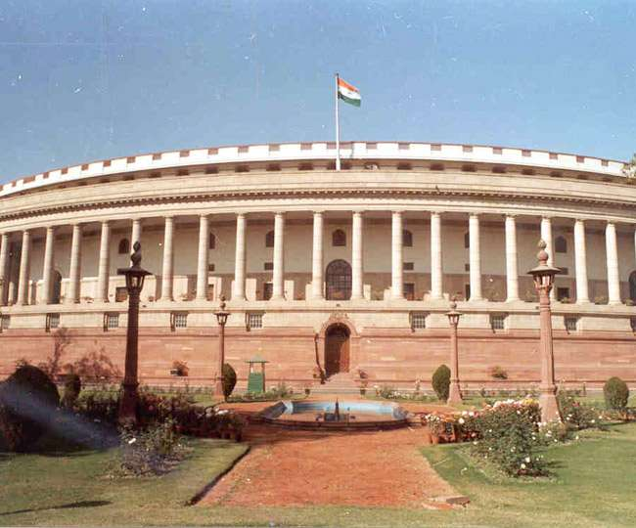
PARLIAMENTARY SYSTEM IN INDIA

Slide 2
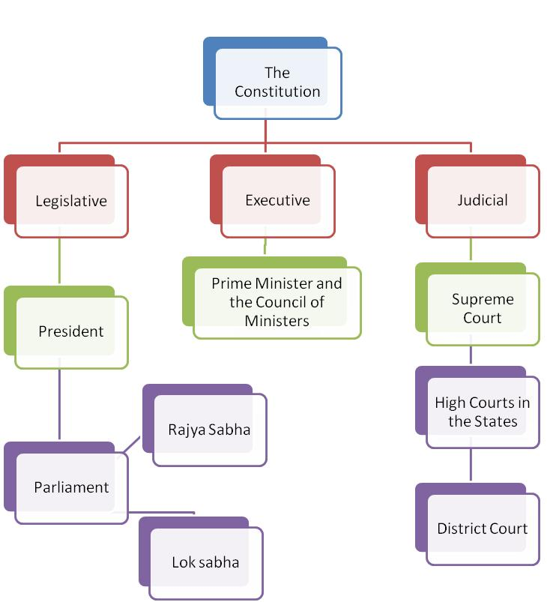

Slide 4
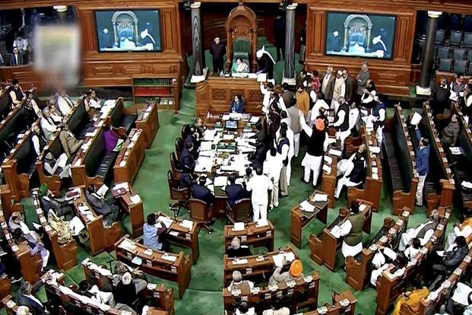

Slide 5
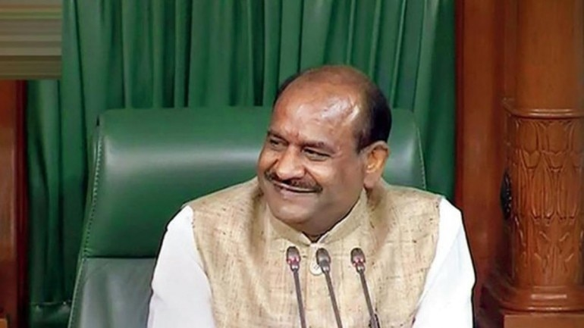
LOK SABHA SPEAKER
MR. OM BIRLA

Slide 7
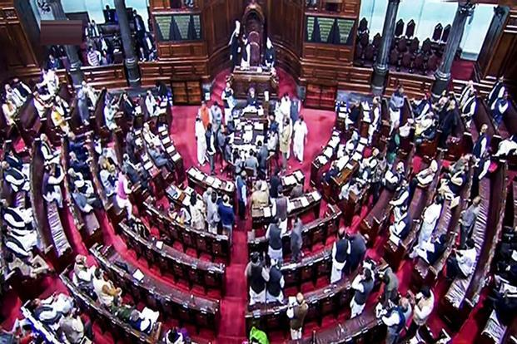
RAJYA SABHA

Slide 8
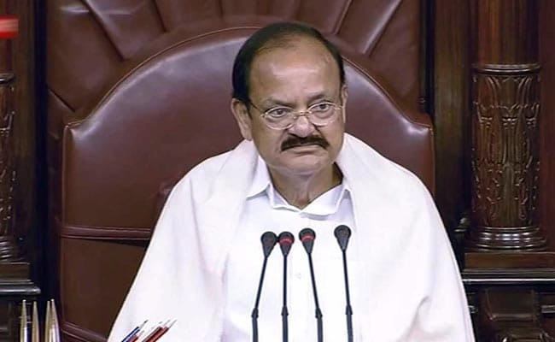
CHAIRMAN OF RAJYASABHA
MR. VENKAIYAA NAIDU
VICE PRESIDENT OF INDIA

Slide 9
PREPARED BY KALYANI S
SNS ACADEMY

Slide 10
